Slide 1
Mid-Progress Presentation
Group #6
High-Bitrate Voice Recorder
Benjamin Hoang, Angelica Olmedo, Jeremy Magana, Jarrett Koran

Slide 2
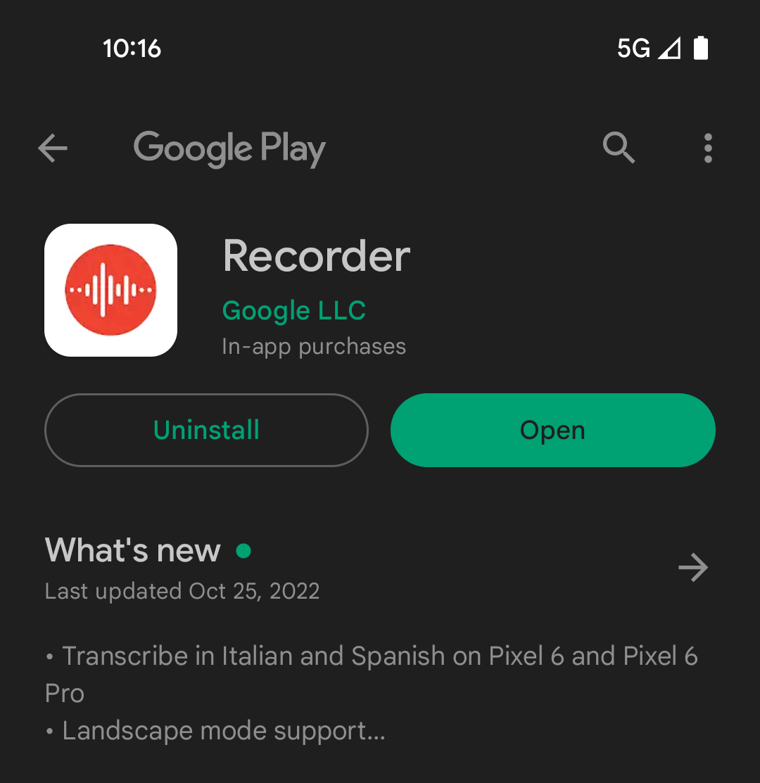
The problem:
Recorder by Google
Included with Google Pixel devices
16 bits per sample
32000hz sample rate
Bitrate of around 48Kbps
What’s wrong with that?
Human hearing range
Less bitrate than even Discord VoIP

Slide 3
Overall Current Status
Our program at the moment has at the moment implemented our fragment system, our navigation system, and the record button at the moment. Our plan for the rest of the program includes features such as asking for permission, possibly implementing firebase database, LiveData and ViewModel for our recording data, and a possible recyclerview list to display all of the recordings. The program will be developed incrementally with personal responsibilities.

Slide 4
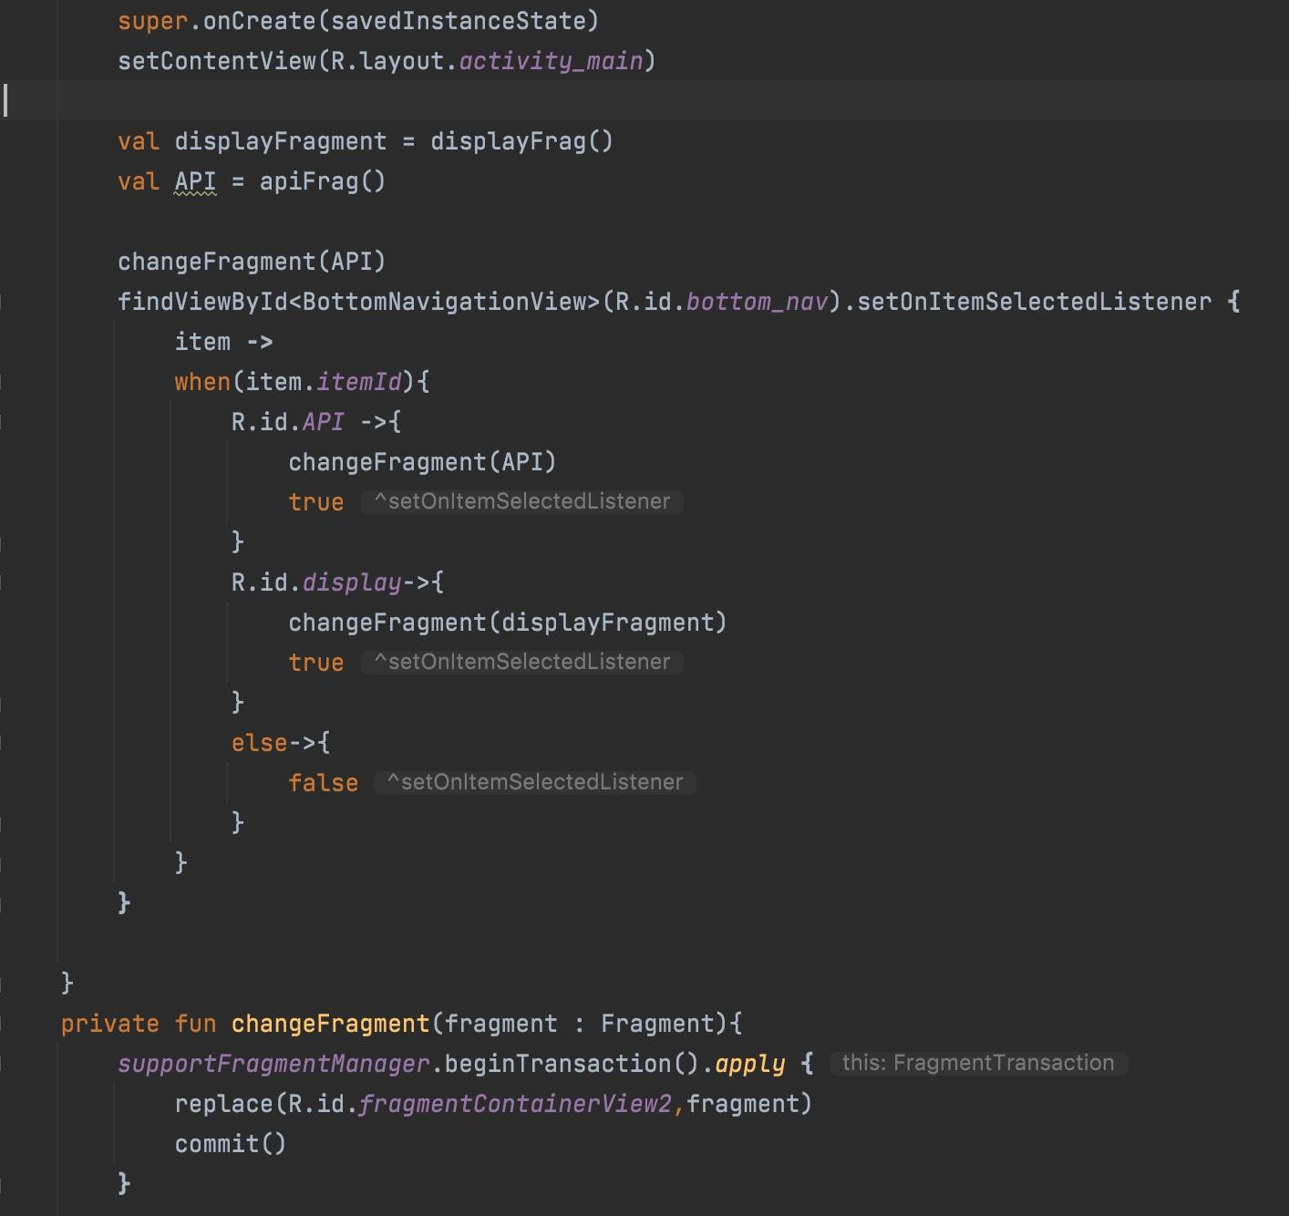
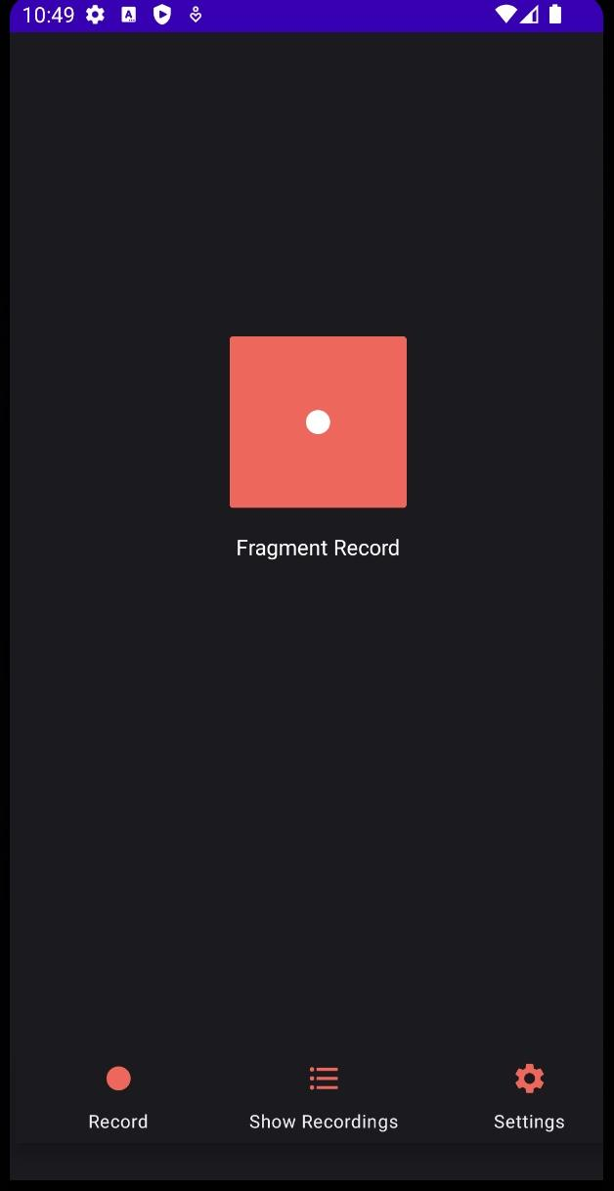
Currently Implemented/Designs

Slide 5
Future Features
Firebase Database (login functionality for users)
Recyclerview list of recordings (when clicked on, displays various details of the recording such as time, name, and length of recording)
Asking for permission because the application needs to be able to write into the storage of the device and needs to be able to access the microphone on the device
Notifications of possible errors from the user. (incorrect user login/incorrect password)
ViewModel LiveData of duration of recording in the middle of recording.
Maybe include a light mode in the settings of the program.

Slide 6
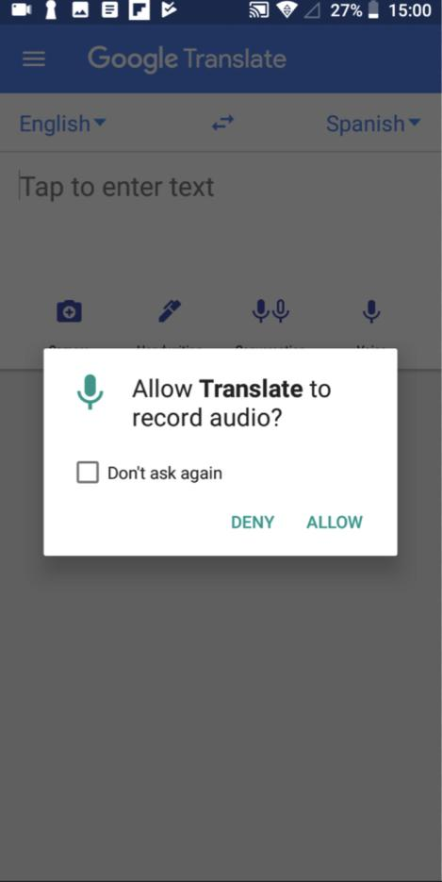
Asking Permissions
Without microphone permission our application will not function
People can accidentally press no for the permission pop up
Add a page that will allow users to request microphone access via a button press
If the user selects no microphone access we will have the button asking permission available to be pressed at all times

Slide 7
Goal
Provide users a way to record high resolution audio, that allows users to have options and configurations.
The project will have all the basic features of a generic voice recorder plus a few more features.
Our goal is to allow users to record at high resolutions either by recording to raw formats or high bitrate compressed formats.

Slide 8
Group work plan
Benjamin Hoang
Recording Functionality
Timer
Receive input
Start and stop
Angelica Olmedo
Save recording history using RecyclerView
Rename options
Store date and time
Delete recording option
Jeremy Magana
Playback features
Play
Back and Forward
Delete recording option
Jarrett Koran
Ask and check for permissions
Setting section
Uploading to Play store

Slide 9
Conclusion
Although our implementation is not at a fairly comfortable level, we expect our planning towards this program to save us significant time compared to implementing the program without a solid mapwork. Our group is prepared for the rest of this project and we are looking forward to presenting our finished product.

